Slide 1

A Statistical Analysis of Crime Rate Correlation to Several Variables Measured Within 47 Unknown U.S. States
Samip Thapa & Ellis Torrance

Slide 2
The Dataset Variables (N=47)
Measured at a time ‘0’ and 10 years later
Dataset Variable Names | Variable Description | Variable Type
CrimeRate | Incidence of crime per one-million citizens | Continuous
Southern | The state being measured is a southern state | Categorical
Youth | The number of males between 18-34yo per 1000 individuals | Discrete
Education | The average number of years school was attended | Discrete
ExpenditureYear | Amount of money spent on police per capita | Continuous
Males | The number of males per 1000 females | Discrete
LabourForce | Males from 18-24yo that are employed per 1000 | Discrete
Wage | Median weekly wage | Continuous
BelowWage | Number of families that make < median wage | Discrete
HighYouthUnemploy | Youth unemployment high (“1”) when YouthUnemployment is > 3x MatureUnemployment | Binary
MatureUnemployment | Number of males between 35-39 who are unemployed per 1000 | Discrete
StateSize | Size of the state population measured in units of hundred thousands | Discrete
MoreMales | Yes = “1” when male/female ratio in Males > 1 | Binary
Notes:
Overview of The dataset

Slide 3
Our Questions:
i) Does the average crime rate change over a ten-year period and how does it relate to the change in education over ten-years?
ii) Has Southern State Crime Rate changed significantly within the last ten years?
iii) Has Northern State Crime Rate changed significantly within the last ten years?
iv) What is the relationship between crime rate and police expenditure?
v) Can the number of families below half wage predict crime rate?
vi) What are the best variables in the dataset for prediction of crime rate in a multiple regression?
Notes:
Our Questions

Slide 4
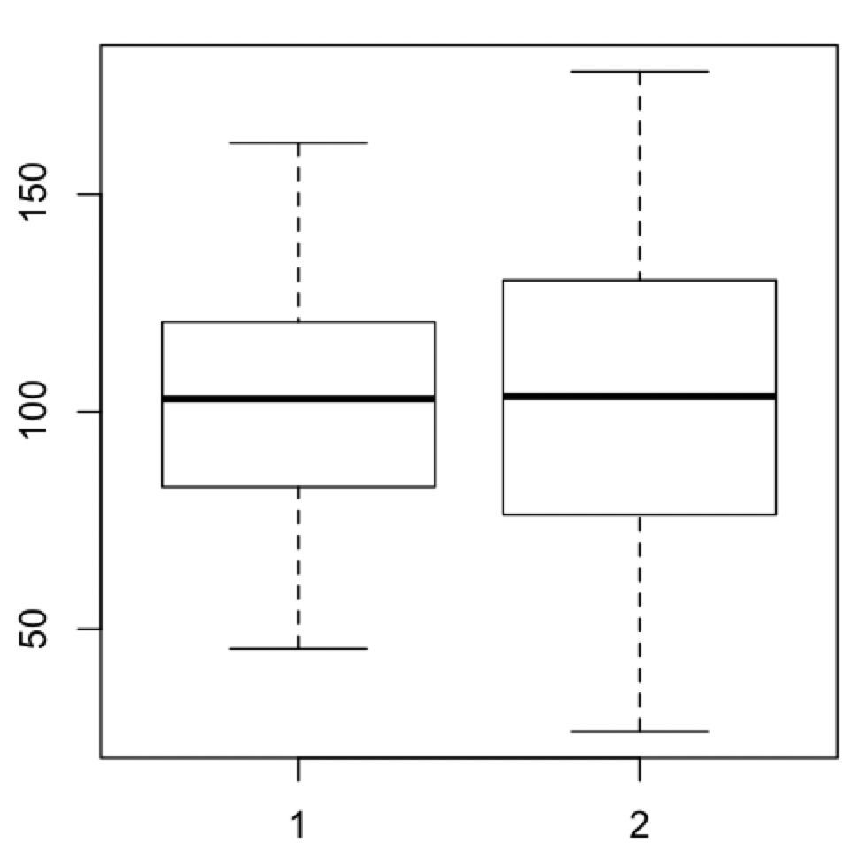
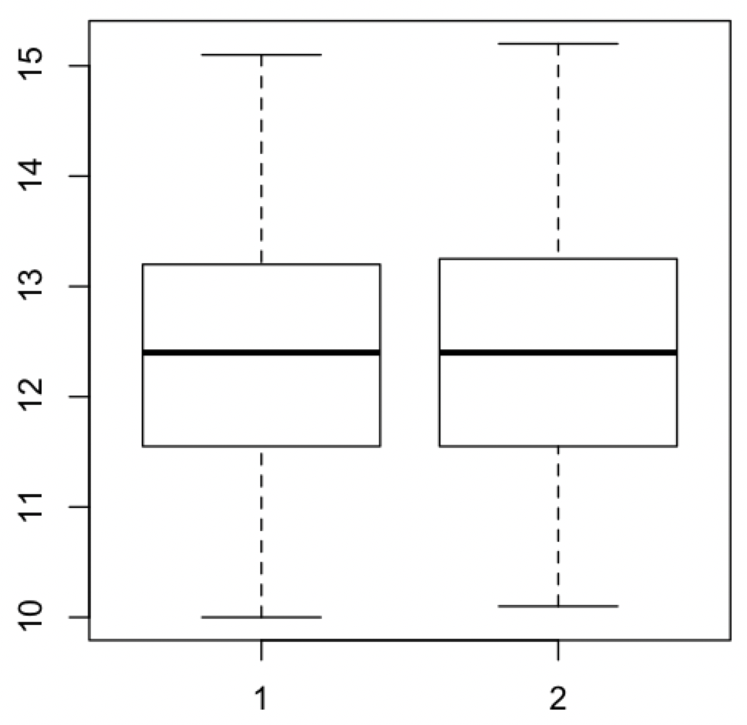
Paired T-test two-tailed p-value = 0.64, d.f. = 46
Paired T-test two-tailed p-value = 0.56, d.f. = 46
A
B
Mean = 102.81±28.9
Mean = 102.07±39.3
Mean = 12.39±1.12
Mean = 12.40±1.17
CrimeRate
CrimeRate10
Education
Education10
Figure 1: Visual demonstration of the distribution in A) Crime Rate (N=47 per group) across the U.S.A. before and after a 10-year period and B) average years of Education (N=47 per group) of the same regions across the U.S.A. before and after a 10-year period.
Notes:
Is there a statistical difference between education before and after 10 yrs and Is there a statistical difference between crime rate before and after 10 yrs?

Slide 5
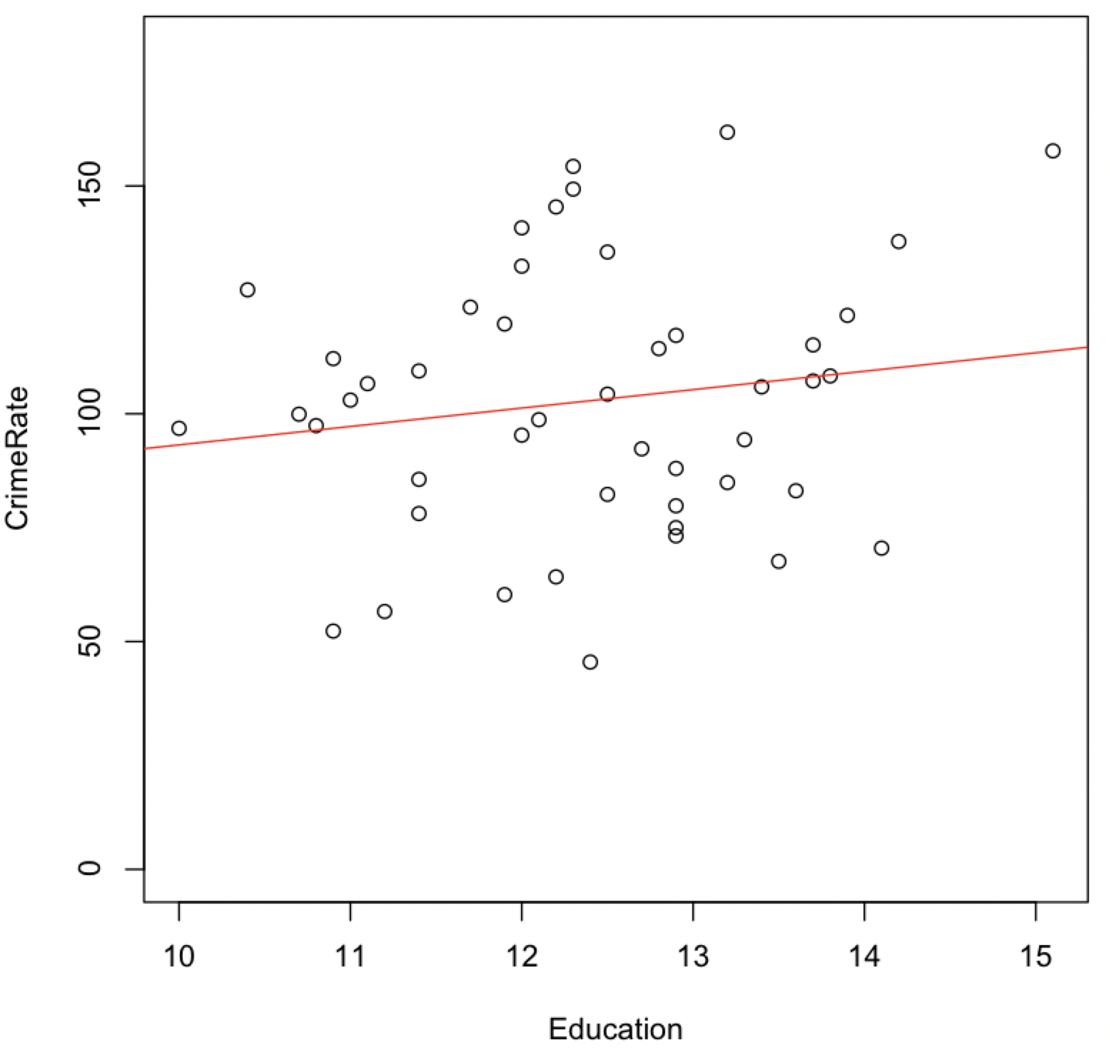
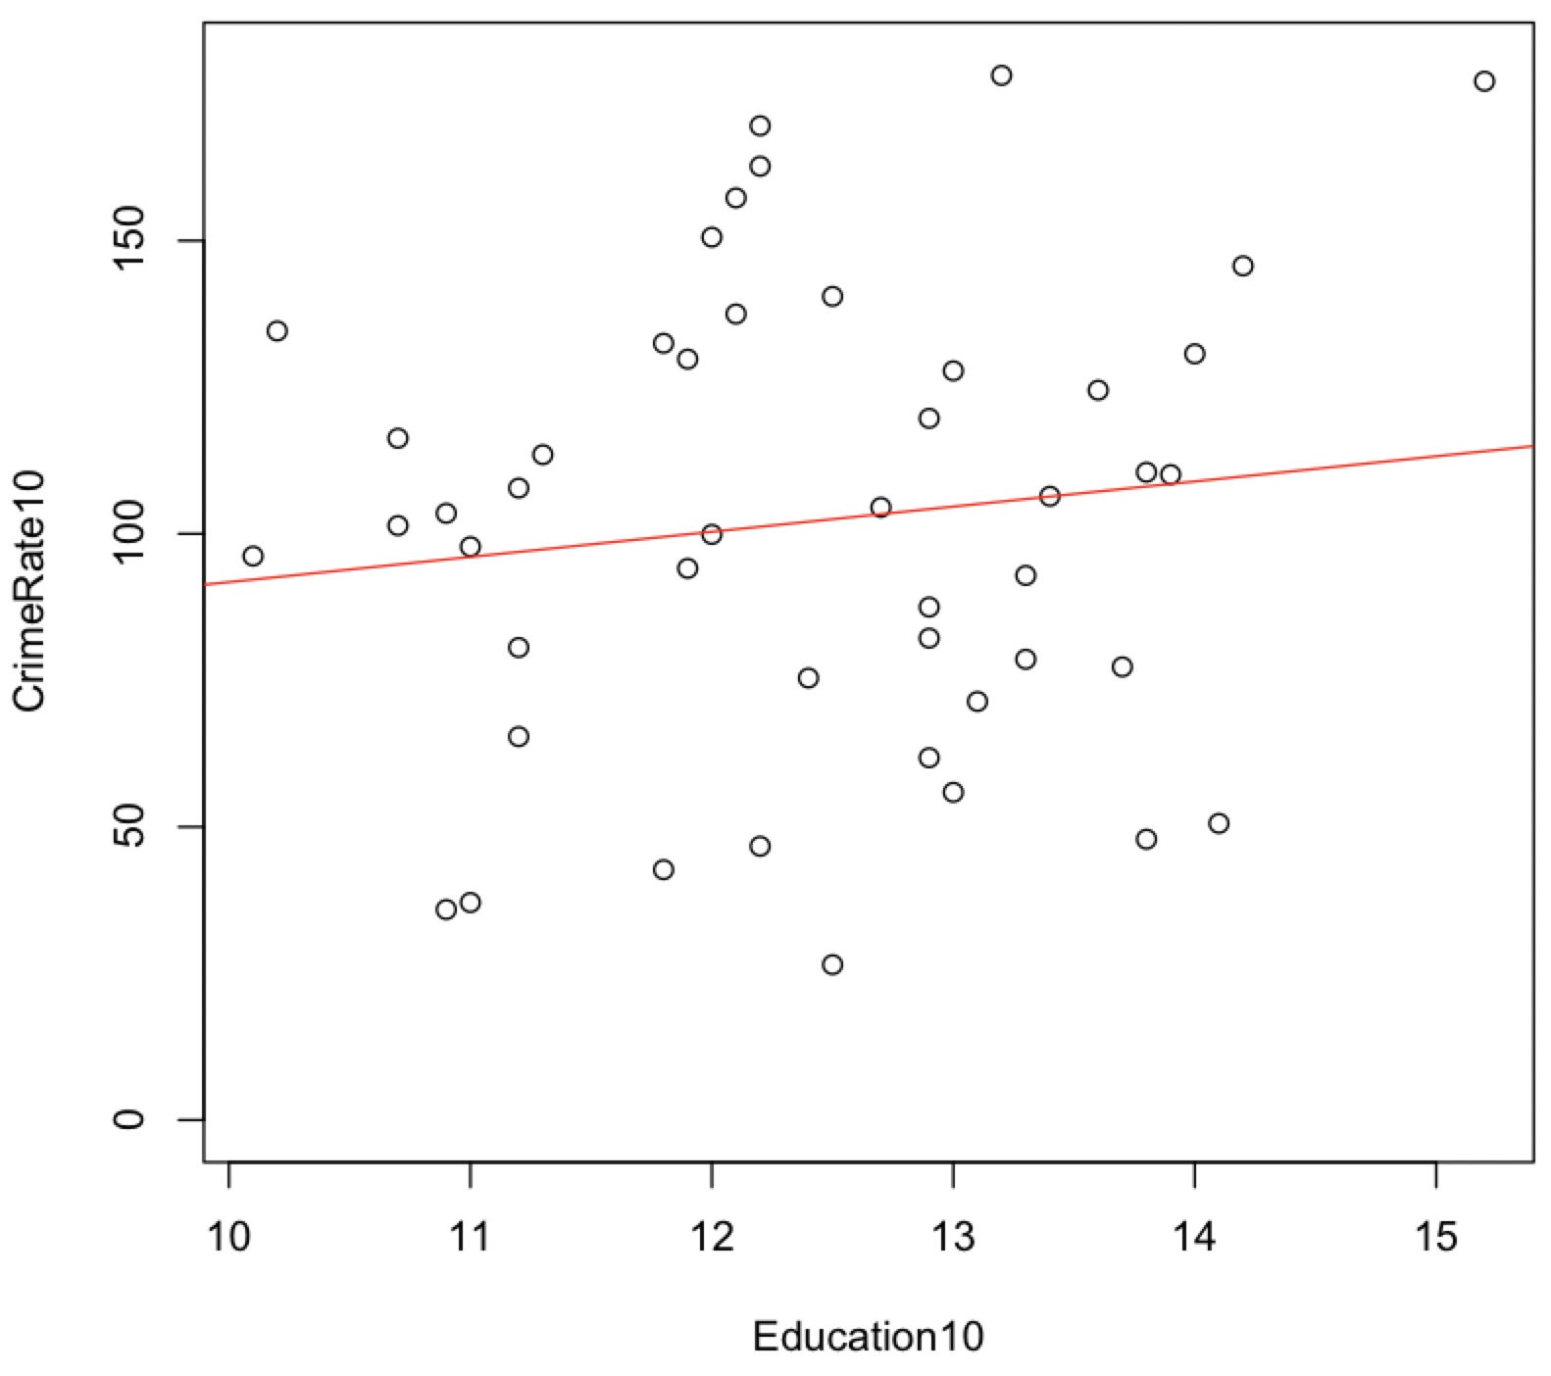
Regression analysis two-tailed p-value of 0.37
Regression Analysis two-tailed p-value of 0.52
B
A
Figure 2: Scatter Plot of the relationship between CrimeRate and Education before 10 years (A) and CrimeRate10 and Education10 after 10 years (B) with a linear regression model applied in red.
Notes:
Indicating that there is no statistical evidence that changes in the predictor variable, Education, are associated with changes in the response variable, Crime Rate in either year zero or year 10. Average years of education in a particular state alone is not enough to predict crime rate.

Slide 6
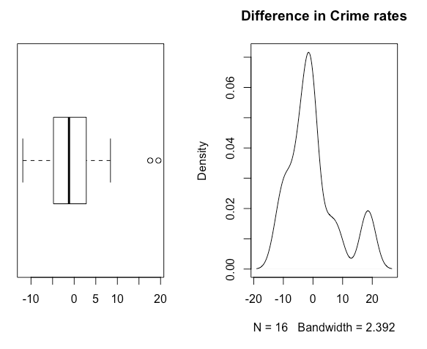
Findings from the paired t-test:
With the outliers:
P-value = 0.9443
With the two outliers removed:
P-value = 0.1138
Fig:3. Difference in Crime rate before and after 10-year period of the Southern state
Notes:
Has Southern State Crime Rate changed significantly within the last ten years?
With the outliers: no statistical evidence that the mean difference between crime rate in southern states before and after a 10-year period is different than zero
With the two outliers removed: no statistical evidence that the mean difference between crime rate in southern states before and after a 10-year period is different than zero

Slide 7
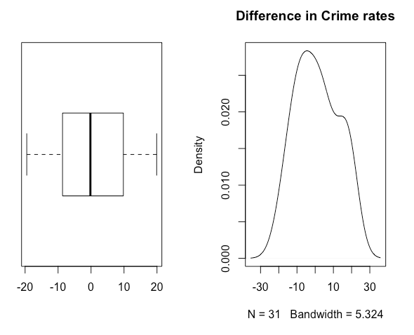
Findings from the paired t-test:
P-value = 0.6263
Fig:4. Difference in Crime rate before and after 10-year period of the Northern state.
Notes:
Has Northern State Crime Rate changed significantly within the last ten years?

Slide 8
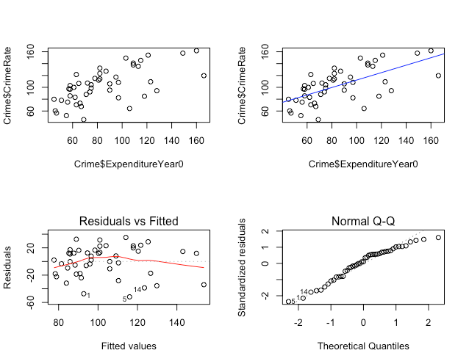
Spearman’s correlation coefficient between crime rate and the expenditure year 0 = 0.6493537
R² = 0.4176
Fig:5. Scatterplot (A), Scatterplot with the fitted line (B), Residual vs Fitted plot (C), and the Normal Q-Q (D) plot to assess linear regression model between crime rate and expenditure year 0
Notes:
What is the relationship between crime rate and police expenditure?

Slide 9
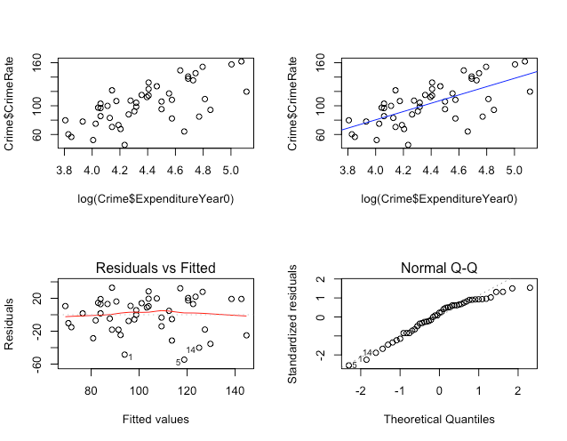
R² = 0.4438
3.92% increase in variation explained by the model in predicting crime rate around its mean
Fig:6. Scatterplot (A), Scatterplot with the fitted line (B), Residual vs Fitted plot (C), and the Normal Q-Q (D) plot to assess linear regression model between crime rate and log (expenditure year 0)
Notes:
The explanatory variable expenditure alone may not be a good predictor for crime rate and a richer model with various other explanatory variables needs to be assessed

Slide 10
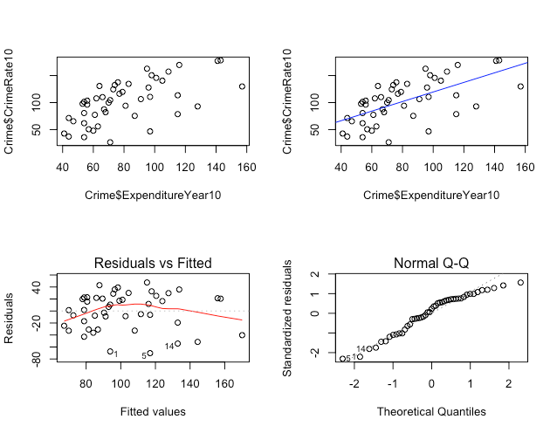
Spearman’s correlation coefficient between crime rate and the expenditure year 10 = 0.6502011
R² = 0.3977
Fig:7. Scatterplot (A), Scatterplot with the fitted line (B), Residual vs Fitted plot (C), and the Normal Q-Q (D) plot to assess linear regression model between crime rate and expenditure year 10

Slide 11

R² = 0.4264
4.21% increase in variation explained by the model in predicting crime rate around its mean
Fig:8. Scatterplot (A), Scatterplot with the fitted line (B), Residual vs Fitted plot (C), and the Normal Q-Q (D) plot to assess linear regression model between crime rate and log (expenditure year 10)
Notes:
The explanatory variable expenditure alone may not be a good predictor for crime rate and a richer model with various other explanatory variables needs to be assessed.

Slide 12
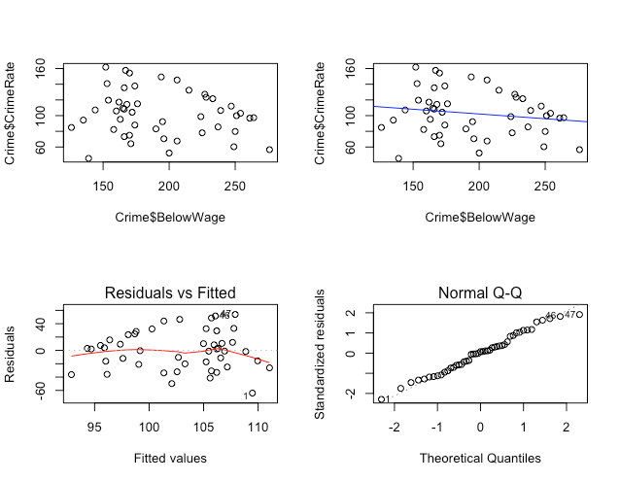
Most of the points do not lie close to the fitted line
The residual tends to depart away from the 0 line
The normal probability plot also does not seem to be close to the straight line
R² = 0.028
Fig:9. Scatterplot (A), Scatterplot with the fitted line (B), Residual vs Fitted plot (C), and the Normal Q-Q (D) plot to assess linear regression model between crime rate and Below Wage at base year
Notes:
v) Can the number of families below half wage predict crime rate?

Slide 13
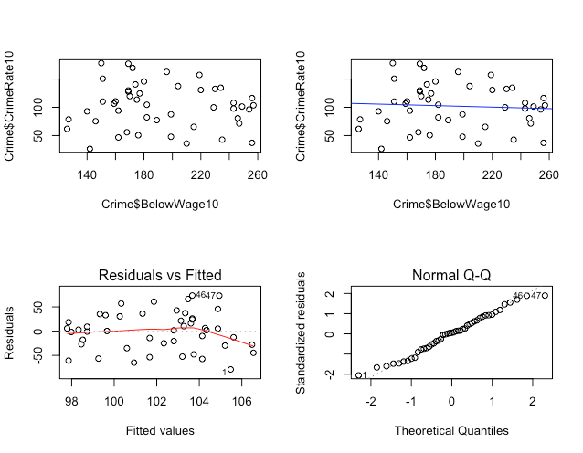
Most of the points do not lie close to the fitted line
The residual tends to depart away from the 0 line
The normal probability plot also does not seem to be close to the straight line
R² = 0.004351
Fig:10. Scatterplot (A), Scatterplot with the fitted line (B), Residual vs Fitted plot (C), and the Normal Q-Q plot (D) to assess linear regression model between crime rate and Below Wage at year 10

Slide 14
Using computer assisted variable selection, all 13 predictors were assessed to determine best subsets of predictors for CrimeRate using Mallow’s C_{p} as a measure of comparison between the models.
The lowest C_{p} score was 3.29 for the model 𝜇(CrimeRate|Youth, MoreMales,Education, ExpenditureYear0, Wage, BelowWage) = -339.3 + 0.77(Youth) +10.4(MoreMales) + 4.8(Education) + 0.7(ExpenditureYear0) + 0.2(Wage) + 0.6(BelowWage)
Multiple R² value of 0.65
Notes:
What are the best variables in the dataset for prediction of crime rate in a multiple regression? multiple R² value of 0.65 indicating that 65% percent of the variation of CrimeRate around its mean is explained by this reduced model.

Slide 15
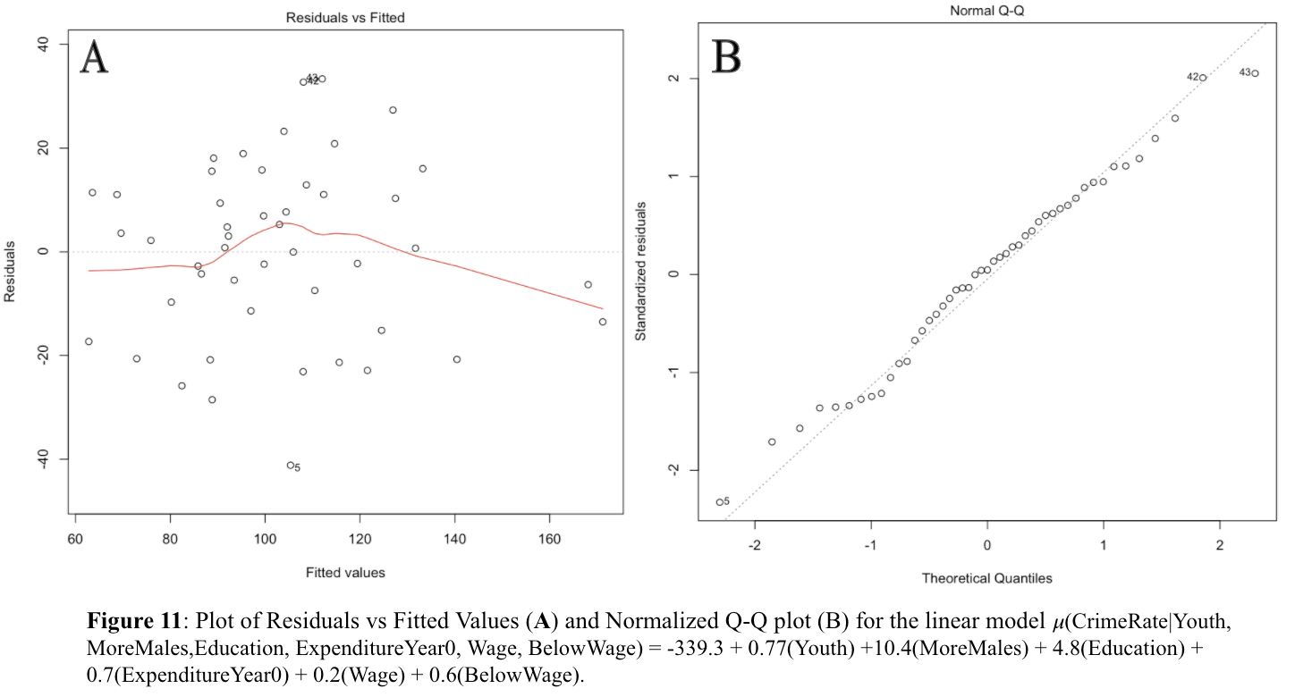
Notes:
Next, we observed diagnostic plots of the reduced model. In (Figure 11A), we see a slight horn-shaped pattern in the center of the graph as the residuals depart from zero in the graph of residuals vs. fitted values which may indicate that the dataset violates the assumption of linearity for the model - indicating the model should be used with caution. The graph also shows 3 potential outliers at points 5, 42, and 43. A Normal Q-Q plot was then used to assess normality of the data (Figure 11B). The linearity of the plot seems to indicate the majority of the data is normally distributed, however the outliers may be contributing some skew as seen at the tails.

Slide 16
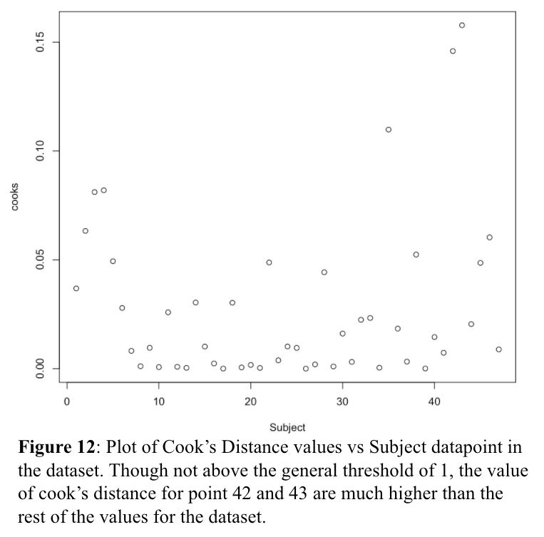
Removal of these points was found to affect the regression coefficients and their p-values and so they were excluded from the analysis.
The new suggested model for CrimeRate prediction with outliers (point 42 and 43) removed is 𝜇(CrimeRate|Youth, MoreMales,Education, ExpenditureYear0, Wage, BelowWage) = -410.1 + 0.73(Youth) +12.4(MoreMales) + 5.5(Education) + 0.5(ExpenditureYear0) + 0.3(Wage) + 0.7(BelowWage) with a multiple R-squared value of 0.70
Notes:
We then applied the influence statistic, Cook’s Distance, to determine whether the points identified as outliers were heavily influencing the slope.

Slide 17
Conclusion
i) Does the average crime rate change over a ten-year period and how does it relate to the change in education over ten-years?
There is no evidence of a mean change in education or crime rate over a 10-year period. Furthermore, Education and CrimeRate are not linearly related.
ii) Has Southern State Crime Rate changed significantly within the last ten years? iii) Has Northern state?
There is no evidence of a mean change in crime rate by Southern or Northern state over a 10-year period.
Notes:
Conclusion - summary of results

Slide 18
Conclusion
iv) What is the relationship between crime rate and police expenditure?
There was a positive correlation between the crime rate and police expenditure in both years of measurement. However, the explanatory variable expenditure alone was not good enough to predict crime rate and a richer model with various other explanatory variables were needed to be accounted for predicting crime rate.
v) Can the number of families below half wage predict crime rate?
Below wage is not a good predictor for crime rate using the simple linear regression in year 0 or year 10 due to violations of linearity even after transformation.
Notes:
Conclusion - summary of results

Slide 19
Conclusion
vi) What are the best variables in the dataset for prediction of crime rate in a multiple regression?
The Variables Youth, MoreMales, Education, ExpenditureYear0, Wage, BelowWage were found to predict crime rate in the dataset with the highest accuracy.
Notes:
Conclusion - summary of results

Slide 20
Dataset: Katy Dobson, “Crime Rate Data” https://www.sheffield.ac.uk/mash/statistics/datasets, University of Leeds (Date Unknown)
Thank you for your time and attention!
Questions?
Notes:
Our Questions

